Slide 1

Chandigarh University
Department of Mathematics
B.Tech. CSE (Core/DS/IT/CC)
Semester-3
Subject Code:25MTT-202
Discrete Mathematics
Unit-2 (Chapter- 2.1.2)
Dr. SARTAJ
DISCOVER . LEARN . EMPOWER

Slide 2

CO mappings

Slide 3

CO-PO mappings
Note: Degree of relevance/correlation: 1-Low, 2-Medium, 3-High, Blank or ‘- ‘- Nil

Slide 4
Topics Overview
Cartesian Product
Venn- Diagrams
Conclusions
Video links
References

Slide 5
Cartesian Product of Two Sets
Definition: The Cartesian product A × B consists of ordered pairs (a, b), where a ∈ A and b ∈ B.
Example: If A = {x, y} and B = {1,2}, then
A × B = {(x,1), (x,2), (y,1), (y,2)}
Applications: Used in databases, relations, coordinate systems.
Dr. Shyam Sumanta Das (Department of Unit-1: Basic Set Theory, Logic, and Functio
ns

Slide 6
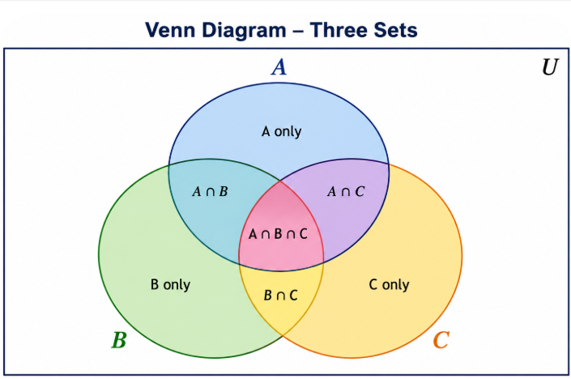
Venn Diagrams
Visual representation of sets
Useful for explaining operations like union, intersection, etc. Example:
(i) A ∪ B = shaded region of both circles
(ii) A ∩ B = overlapping area

Slide 7
Activity-1
1. Find A x B, A-B, A ∪ B and A ∩ B if A = {2, 3} B = {1,2,3}.
2. Given a set S = {1, 2, 3}, list all its subsets. Also find its power set.
3. Find cardinality of a set A containing n-elements.

Slide 8
Conclusion
Cartesian Product of two sets are discussed.
Sets operation using Venn diagrams are given.
Their related examples and activities are observed.
ns

Slide 9
Video Links
https://www.youtube.com/watch?v=zhKu0lQW0a8&list=PLFW6lRTa1g83LYdhDkUQfkXs7EbMBwYuF
https://www.youtube.com/watch?v=zDkD0liU_1g

Slide 10
References
Sr. No. | Author | Name of the Book | Publisher | Year of Publication
1 | Kenneth H. Rosen | Discrete Mathematics and Its Applications | McGraw-Hill | 2019
2 | C. L. Liu | Elements of Discrete Mathematics | McGraw-Hill | 1996
3 | J. P. Tremblay, R. Manohar | Discrete Mathematical Structures with Applications to Computer Science | Tata McGraw Hill | 2001
4 | Kolman, Busby, Ross | Discrete Mathematical Structures | PHI | 2001
5 | Narsingh Deo | Graph Theory with Applications to Engineering and | PHI | 2017

Slide 11
Thanks!!!

